Slide 1

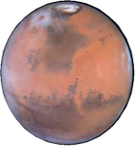
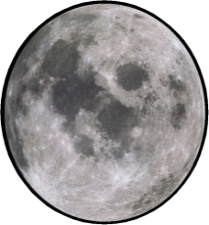



Human-Agent Interaction for Human Space Exploration Ariel Rosenfeld Bar-Ilan University UMAP 2019, Cyprus

Slide 2
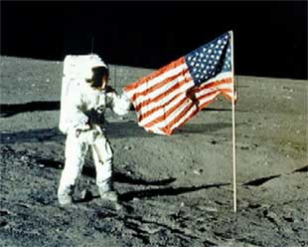
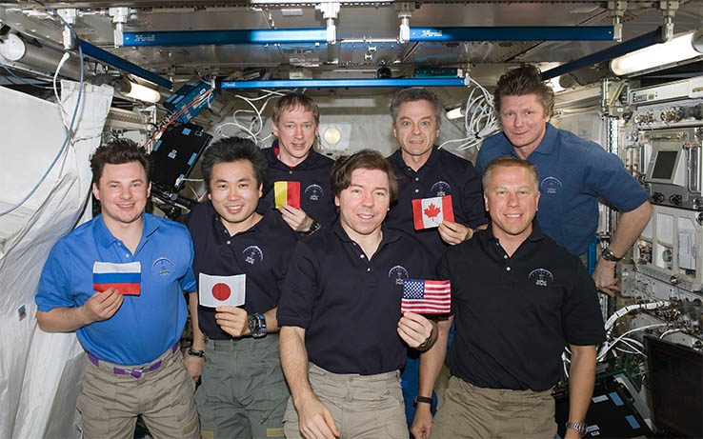

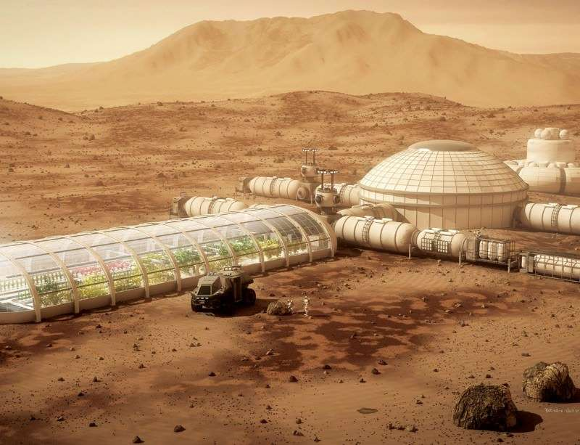
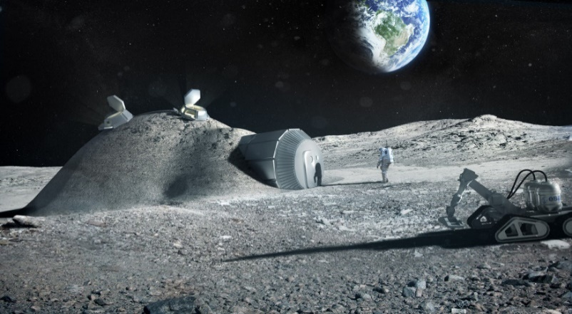
Today
Tomorrow
ESC
NASA
Notes:
Following past human achievements in space, including orbiting the earth, the moon landings and the cooperation in the international space station to name a few,
there is a renewed interest among space agencies to extend human space travel and inhibit other planets.
These include the European Space Concuil’s plan to create a so-called moon vilege and NASA’s journay to Mars prog. Aimed at establishing a colony on Mars.

Slide 3
UMAP in Space?
Unprecedented level of autonomy.
Many challenges.
Isolation
Risks
Cognitive and psychological demands
Agent technology can assist
Bounded by the ability to model, adapt and personalize its behavior.
Notes:
So what does this community has to offer for space explorations?
Well, first, astronouts exploring deep space will have an unprec. Level of autonomy.
Specifically, due to the costly communication and delays we cannot having a human specialist following the astronauts, instructing then and intervining in their work.
To assist these astronauts in coping with the many challenges associated with space exploration, for example, the physical and social isolation, the high risks and costs of mistakes and the cognitive and psych. Demands, agent technology can be put to use.
However, these agents are bounded by their ability to proficiently model, adapt and personalize their behavior to each astronaut and/or to a group of astronauts,

Slide 4
Two Avenues for Exploration
Assisting each astronaut individually
Monitoring for undesired personal conditions
Prognosis
Intervention
Facilitating Teamwork
Promoting fairness and group satisfaction
Automated task allocation
Resolving interpersonal conflicts
Notes:
For the upcoming break, I would like you to consider 2 avenues for further exploration:
Assist ind. Ast.
This may be performed by monitoring for undesired personal conditions
Perfoming prognosis, naemy, predicting the expected contniation of an undesired state (for example, is it likely to improve or deteriorate) and, most importantly, providing interevtions in an automated way.
For example, say that a mild case of depression is identified for one of the astronouts, if the agent predicts that the astronaut’s condition is likely to improve given his expected work load and tasks then there may not be a real need to intervene. However, if not, the agent may provide information or entertainment, of even modify the astronaut’s schedual to cope with the condition.
For a group perspective, an agent can assist in promoting fairness and group satisfaction. For example, in light of their high level of autonomy, astrs may wish to decide what they will eat for each meal. Using simple majority decision for each meal may bring about poor satisfaction to astrs that are always in minority opinion. Developing novel rec. systs that account for these effects may be desiered.
Similarly, automated task allocation may need to account for the changing preferences of the astrns and the dynamic needs from the team
Finally, agents may assist in resolving interpersonal conflcits through argumentation and mediation.

Slide 5
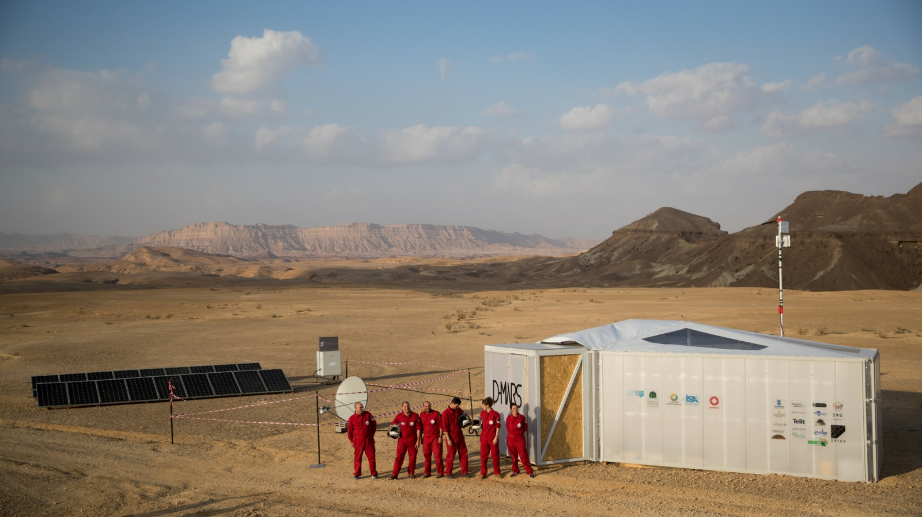
The Data is Out There!
Analog Space Programs (ASPs)
NASA (https://www.nasa.gov/hrp)
Austrian Space Forum OeWF (https://oewf.org/)
D-MARS (https://www.d-mars.org/)
ESA (http://www.esa.int/)
….
FREE* and seeking research proposals
Notes:
You might be saying to yourselfs, this is all nice and well, but how can I test such systems? My grants do not cover space explorations!
Well, luckly enough, there are several analog space program all around the well that actively solicit research proposals from all scientific disciplines.
These analogs are built all across the world in places which resemble either the moon or Mars conditions.
This picture is from the Israel ASP situated in the Mitzpee Ramon area, claimed to be the closest place on earch to Mars conditons.
These ASPconduct different mission throught the year and offer to perform experiments or collect data for scientific enquiry for free or almost free.

Slide 6

Summary
Unique challenges and opportunities
Assisting Astronauts and Promoting Teamwork
Real-world evaluation at minimal cost
Human-Agent Interaction for Human Space Exploration, UMAP 2019
arielros1@gmail.com
www.arielrosenfeld.com
Ariel Rosenfeld
Notes:
To summaries, there are unique challenges and oppretunities for this community associated with space explorations.
I belive that the two avenues I discussed, …, can be very fruitful based on our technological activity here at this conf.
Remember, there are real-world simulated evn. To test developed system and personally, I can assist with DMARs with which I’m involved.
Thank

