Slide 1
Playing Chess at a Human Desired Level and Style
Notes:
Hello, my name is Hanan Rosemarin.
I am from Bar-Ilan University in Israel.
The title of my talk is: “Playing Chess at a Human Desired Level and Style”.
This research was conducted with Ariel Rosenfeld.

Slide 2

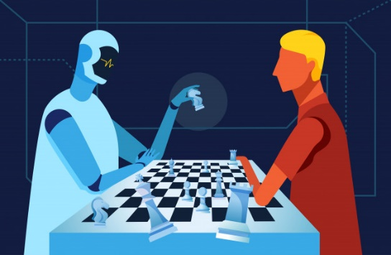
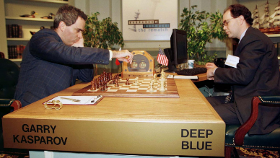

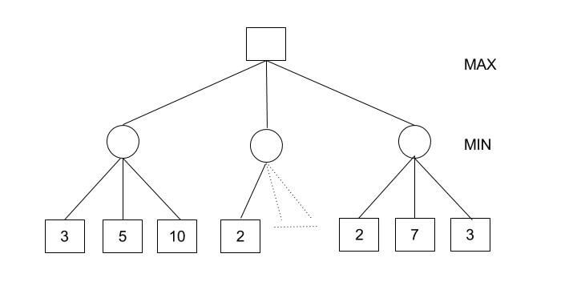
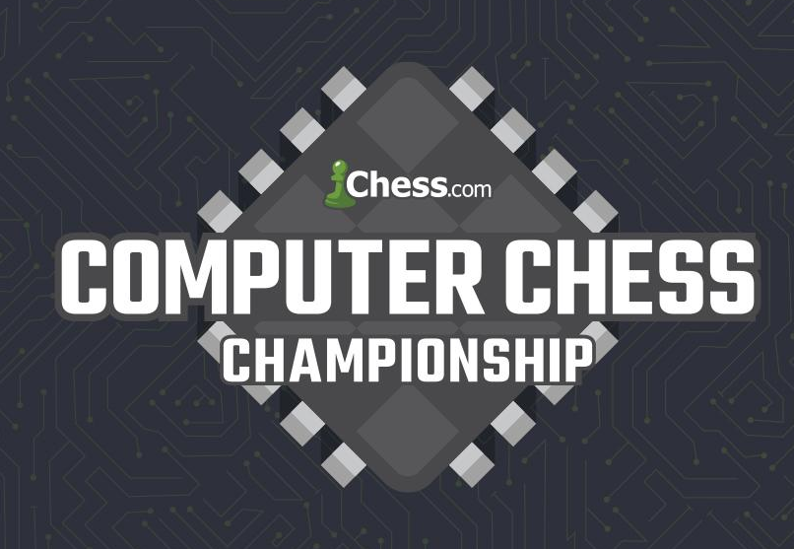
Chess and AI
Notes:
<Click> Mastery of chess is synonymous with intelligence. It comes as no surprise that AI pioneers tried to build Chess playing agents <Click> In fact before McCarthy coined the term “AI”, Turing and Shannon described a chess agent. <Click>
´Refinements of Shannon’s MiniMax game tree search algorithm were used in the “Deep-Blue” chess program that defeated Gary Kasparov in 1997
<Click> Current Chess programs are able to surpass the level of all human players, and the academic interest in further optimizing chess agents has faded.
<Click>
Currently, Chess “engines” hold tournaments among themselves

Slide 3
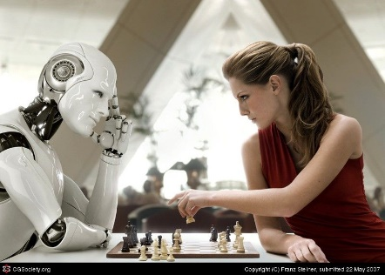
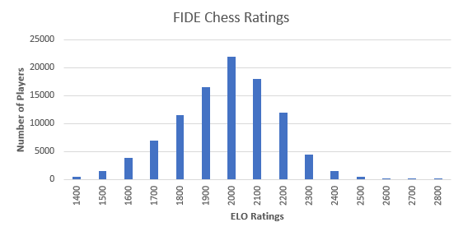

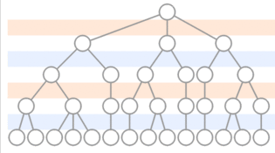
Chess Agents as Human Training Partners
Notes:
<Click> While chess engines have achieved super-human level of play, they are lacking in their ability to act as a training partner for a human player <Click> The level of play is measured using the ELO rating system, which converts a pair-wise win-rate ratio to a score difference <Click> The strength of Chess engines comes from: highly tuned evaluation functions and deep tree searches using extensive resources (time*cpu) As a result, common attempts to “dumb down” chess engines to human level are based slightly on degrading the board position evaluation function (adding randomness) but mostly on limiting tree depth and time per move

Slide 4
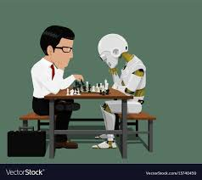
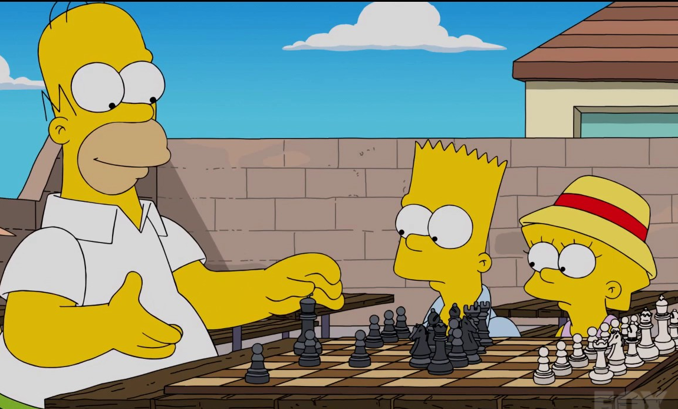
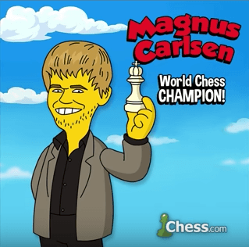

Chess Agents as Human Training Partners
Notes:
As a chess engine is tuned to achieve a certain ELO rating, that is achieve a certain win ratio, the end result is an erratic level of play: a combination of <Click> grand-master moves with occasional <Click> “blunders” (chess lingo for very bad move). It is well known that in order for a training partner to be effective “it” must play at level similar to that of the player. <Click> Current chess engines are not good training partners as they do not degrade their level in a human-like fashion. Moreover, minimax based engines are claimed to have a “mechanical” style of play. Some claim that as human players train with computer agents they adopt that style of play. In effect having humans mimic computers – Artificial Intelligence in reverse…..

Slide 5
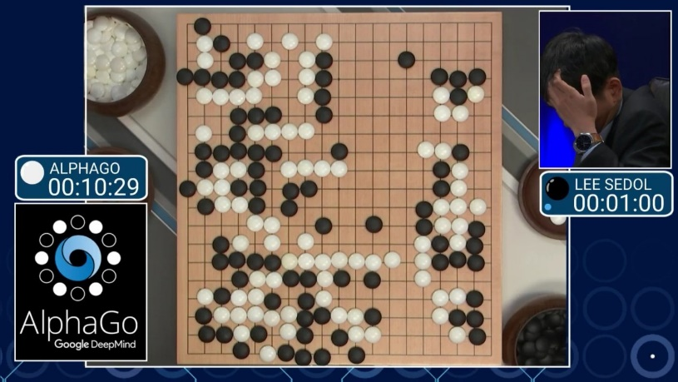
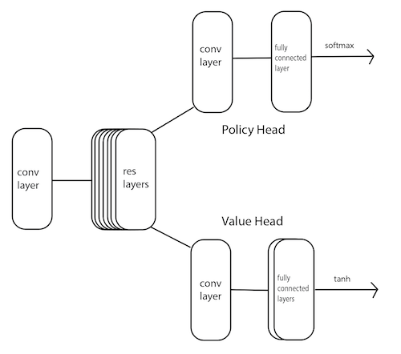
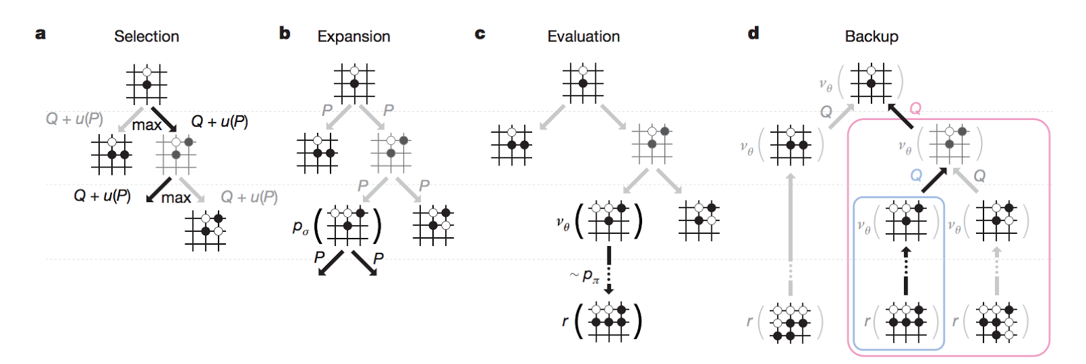

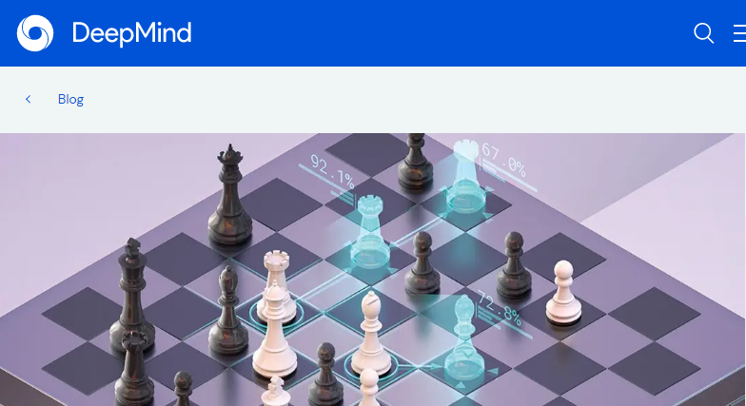

Alpha Zero Chess
Notes:
While Chess and similar games were “solved” by alpha beta tree search, games with wider trees, that is large branching factors remained out of reach for these algorithms. The game of Go was a typical example of a such a game <Click> In 2016 DeepMind managed to defeat a Go grand master (Lee Sedol) using an agent based on
<Click> Monte-Carlo Tree-Search which was trained using self play with Reinforcement Learning Deep Networks, and was initialized from human master games. (The agent ran on ~2,000 CPUs and ~300 GPUs) The building blocks used by DeepMind were not new: training by self play was introduced in the 90’s for Backgammon, and MCTS and the deep neural network techniques were available as well, yet their combination demonstrated a level and style of play that was unprecedented
The algorithm was improved both by minimizing required resources and by removing the need for initial games, effectively training from scratch: “tabula rasa training” <Click>
The success of the algorithm was demonstrated on Chess and similar variants (Shōgi)
<Click>
Since, unfortunately, Deepmind has not made their trained network and code available we are using the open source project “LC0” which was trained by crowdsourcing computer resources over the internet

Slide 6
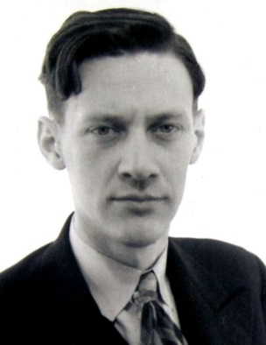
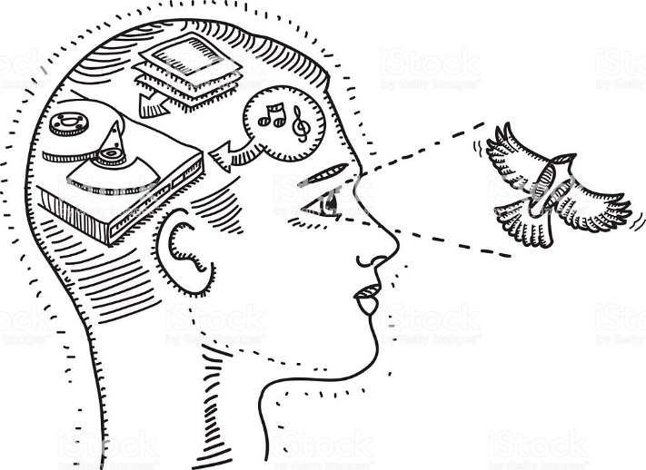
Cognitive Abilities of Chess Players
orientation
exploration
Investigation
proof
Intuition
Analysis
Adriaan de Groot
Notes:
Psychologists have been studying chess players for more than a century. <Click> Adriaan de Groot, a psychologist and chess master, studied chess players’ cognitive abilities for decades
De Groot partitioned the thought process of move selection to 4 stages: <Click> orientation; exploration; investigation; proof <Click> The 1st stage, orientation, is based on intuition: recognizing patterns in the position <Click> The latter stages, require analysis of potential game trajectories <Click> Advanced players improve both capabilities (they both depend on good memory, specifically visual memory)

Slide 7
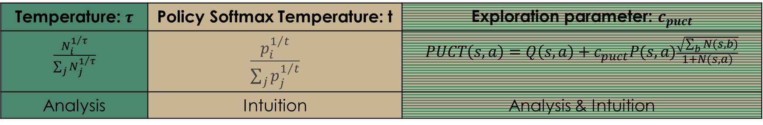
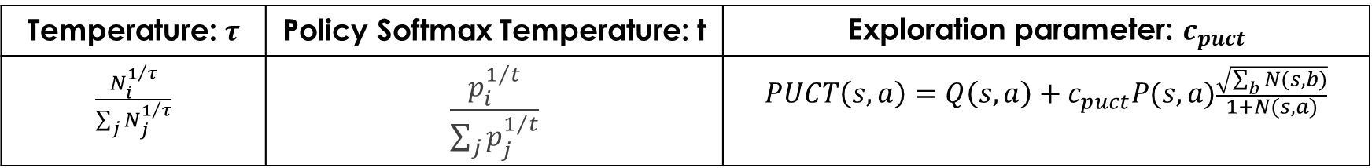
Human Intuition and Analysis Modelling
Temperature: $τ$ | Policy Softmax Temperature: t | Exploration parameter: $c_{puct}$
$$\frac{N_{i}^{1/τ}}{\sum_{j}{N_{j}^{1/τ}}}$$ | $$\frac{p_{i}^{1/t}}{\sum_{j}{p_{j}^{1/t}}}$$ | $$PUCT\left(s,a\right)=Q\left(s,a\right)+c_{puct}P(s,a)\frac{\sqrt{\sum_{b}{N(s,b)}}}{1+N(s,a)}$$
Temperature: $τ$ | Policy Softmax Temperature: t | Exploration parameter: $c_{puct}$
$$\frac{N_{i}^{1/τ}}{\sum_{j}{N_{j}^{1/τ}}}$$ | $$\frac{p_{i}^{1/t}}{\sum_{j}{p_{j}^{1/t}}}$$ | $$PUCT\left(s,a\right)=Q\left(s,a\right)+c_{puct}P(s,a)\frac{\sqrt{\sum_{b}{N(s,b)}}}{1+N(s,a)}$$
Analysis | Intuition | Analysis & Intuition
Notes:
<Click> Alpha-Zero’s neural network has two outputs (also known as heads) <Click>
Policy head – outputs a probability vector over possible next moves
Value head – outputs a win estimation for current position, a number between -1 and 1 <Click>
The initial move probabilities are refined using a variation of Monte-Carlo-Tree-Search <Click>
We focus on keeping the trained neural network and modifying the MCTS hyper-parameters.
As this does not require the complex and time-consuming re-training of the DNN for each desired play level, and additionally it enables a gradual parametric tuning of the level of play The MCTS hyper-parameters used to degrade the agent’s level are:
<Click> Temperature (tau): which controls the randomness in move selection. When the temperature is 0 the best move is selected (move with highest visit count). As the temperature is increased, the probability of selecting less promising moves is increased: Policy Softmax Temperature (t): which controls the probability of move selection in the MCTS expansion phase. When t equals 0, the move with highest policy probability (from the policy head of the network) is selected. As t is increased the probability becomes more uniform: Exploration parameter (𝒄_𝒑𝒖𝒄𝒕): which controls the trade-off between exploration and exploitation <click> The parameters can be interpreted in terms of the human cognitive abilities
Temperature, tau: is akin to analysis since higher temperature means the agent is less certain about the relative value of explored board positions
Policy Softmax Temperature, t: is akin to intuition as lower temperature means greater reliance on the highly tuned policy head of the neural network – in effect recognizing good moves and promising patterns in board positions
Exploration parameter, 𝒄_𝒑𝒖𝒄𝒕: is an enabler of both abilities as it promotes the the exploration which is governed by the previous parameters

Slide 8

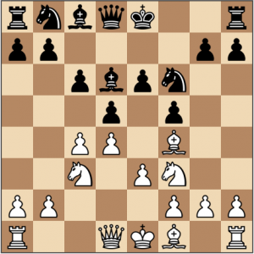
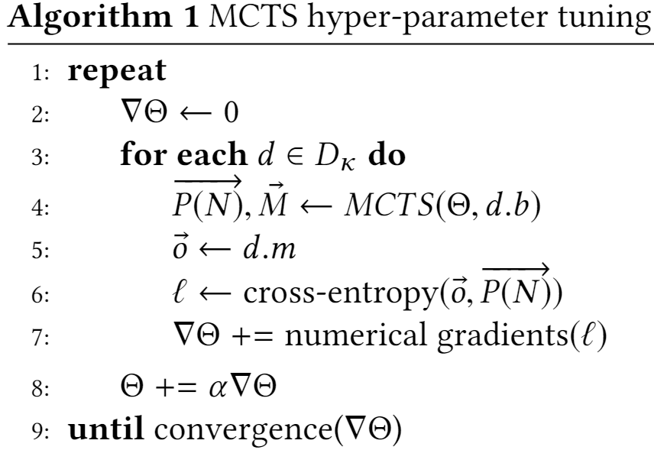



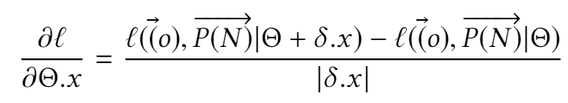
Training MCTS Hyper Parameters
GM
E
B
GM
D
E
Class | Elo range | Description
D | 1200-1300 | strong social player
B | 1600-1700 | above average tournament player
Expert | 2100-2200 | national expert / candidate master
Grandmaster | 2500-2600 | Highest international chess level
B
D
Notes:
The hyper-parameters are tuned by a numerical version of the stochastic gradient descent used in supervised machine learning <Click>
We start by collecting a data set of games from human players at a given level from the LiChess public database.
<Click>
We focus on moves from mid-game, as initial and end game moves are usually memorized, and the mid-game is a better predictor of the intuition and analysis capabilities of the player. <Click>
For each board position,
<Click>
we note the move taken by human player, which serves as the learning target label
<Click>
Using the agent to predict next move, we obtain a probability vector over moves
<Click>
We calculate loss function as the cross-entropy between the prediction (probability vector - green arrows) and the actual move (one-hot vector shown as a red arrow).
<Click>
Collect batch of losses and update parameters using numerical gradient descent Thus for learning gradients of three hyper-parameters the agent is invoked 4 times - once for the base policy and three additional times for the parameter variation.
<Click>
The procedure is repeated to create 4 agents for the following ELO levels: D - a strong social player in the elo range 1200 to 1300 B - above average tournament player in the elo range 1600 to 1700
Expert - national expert or candidate master in the elo range 2100 to 2200 Grand Master - the highest international chess level (for humans…) above elo 2500

Slide 9
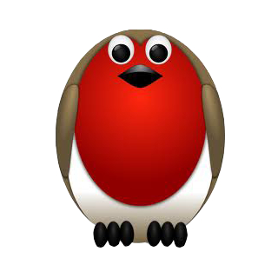
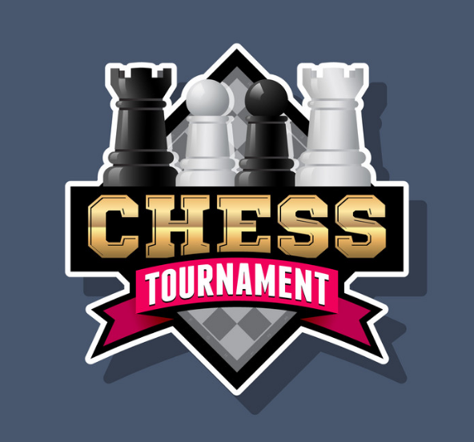



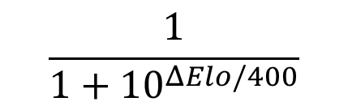

Experiments – Relative ELO
D
$$ΔElo=400$$
G M
B
E X
$$ΔElo=400$$
$$ΔElo=500$$
$$\frac{1}{1+{10}^{ΔElo/400}}$$
Notes:
After training four agents to the four levels described previously, we performed the following experiments:
Relative ELO - we performed extensive round robin tournament between agents. <Click> Verifying that the relative win-ratio is inline with the expected ELO difference, <Click> which follows this formula. <Click> Recall, that our for agents were trained with the following ELO difference

Slide 10
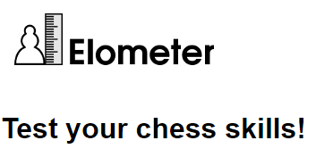
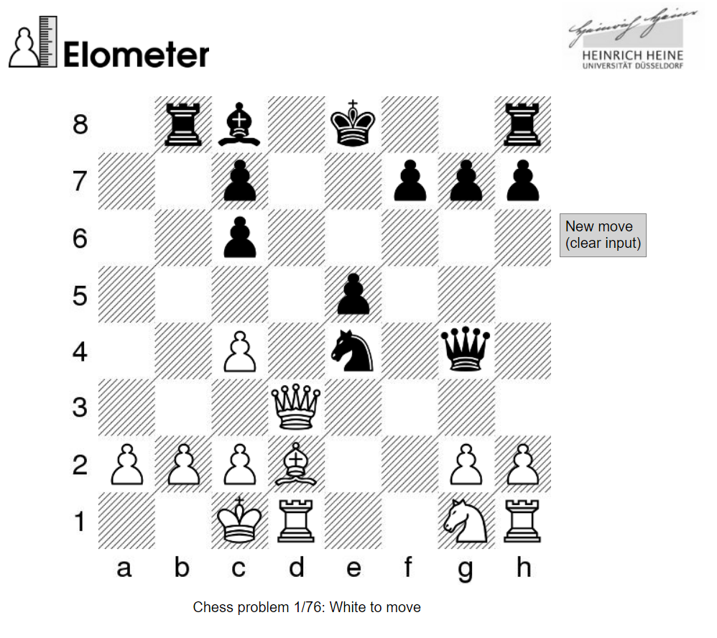
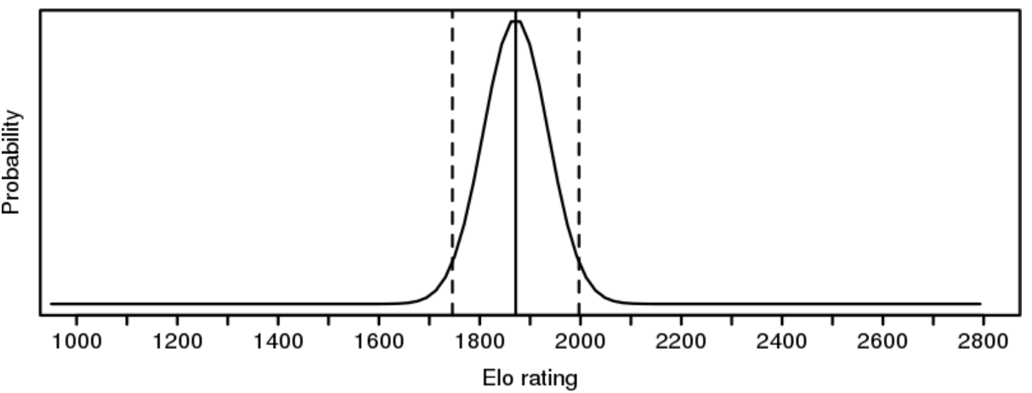
Experiments – Absolute ELO
D
G M
B
E X
Notes:
Since the previous experiment only measures the relative level of the trained agents, the next experiment seeks to measure the absolute level of the agents. <Click> We do this using the ELOMETER web site, which is well known for accurately assessing the absolute level of players. <Click> The level assessment is performed by recording the player’s (or agent in our case) move for 76 specialized chess puzzles, which were selected to identify the human cognitive abilities of chess player. <Click> ELOMETER provides a statistical estimate of the ELO level of the players. <Click> This is repeated multiple times for each of the four agents to get an average elo estimate.

Slide 11
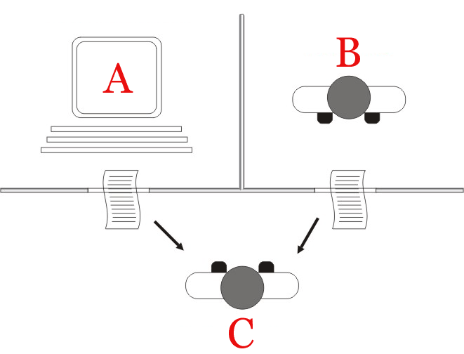
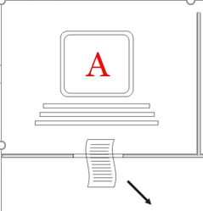

Experiments – “Turing test”
Adaptive Chess Engine
Human
ACE
Shredder
Notes:
The final test uses a human chess expert to validate our assumption that our trained agents not only achieve the desired win-ratio, but also play at a more “human” style of play. (? we additionally asked the chess expert to identify the absolute level of the agents by classifying moves to one of the four levels) <Click> Recall that in a classic Turing test a human is asked to classify whether responses to queries arrive from a human or a machine <Click> Similarly, we collect board positions and selected moves from games between human players, games between instances of the Shredder chess engine, and between instances of our agent which we call ACE <Click> for Adaptive Chess Engine The human chess expert is asked to classify whether the move was made by a human or machine The experiment is repeated for the four elo levels, and the chess expert was informed of the current ELO level

Slide 12


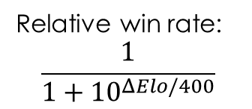

Results – Relative ELO
D
$$ΔElo=400$$
Relative win rate:
$$\frac{1}{1+{10}^{ΔElo/400}}$$
G M
B
E X
$$ΔElo=400$$
$$ΔElo=500$$
Pred / Actual | D | B | Expert | GM
D |  | 0.091 | 0.006 | 0.001
 |  | 0.105 | 0.002 | 0.000
B | 0.909 |  | 0.053 | 0.006
 | 0.895 |  | 0.039 | 0.005
Expert | 0.994 | 0.946 |  | 0.091
 | 0.998 | 0.961 |  | 0.065
GM | 0.999 | 0.994 | 0.909
 | 1.000 | 0.995 | 0.935
Notes:
The results of the experiments are as follows: For the relative elo test, <Click> We record the relative win-rate of the agents, and compare it to the theoretical win-rate predicted by the ELO difference. We ran several hundred games between each pair of agents using the CuteChess program. <Click>
The results are given in the table. As you can see, the win-rate is indeed very close to the predicted win-rate

Slide 13
Results – Absolute ELO
 | Ref ELO | Est ELO
D | 1200-1300 | 1316
B | 1600-1700 | 1727
Expert | 2100-2200 | 2108
GM | 2500-2600 | 2546
Notes:
For the absolute level estimate, we averaged several ELOMETER estimates for each of the four agents. The results are summarized in the table: <Click> As you can see the estimate is close to the trained ELO level, and is slightly over-estimated for the two lower levels. This is in-line with reports from chess players online, namely ELOMETER overestimates the level of players with lower rating.

Slide 14
Results – “Turing test”
Human
ACE
Shredder
72 Games
18 x Class D
6 x HvH
6 x SvS
18 x Class B
6 x HvH
6 x AvA
6 x SvS
6 x AvA
18 x Class Ex
6 x HvH
6 x SvS
6 x AvA
18 x Class GM
6 x HvH
6 x SvS
6 x AvA
 | Human | Machine
Human | 50% | 50%
ACE | 50% | 50%
Shredder | 0% | 100%
Notes:
For the last experiment, the Turing test, we collected a dataset of 72 games <Click> 18 games for each of the the four ELO levels, further divided into 6 games of different player types: human-human ; shredder-shredder ; ACE-ACE A chess expert was asked to classify games as “human” or “machine”. The results are given in the table:
<Click> As can be seen the expert classified all of Shredder’s moves (a leading chess engine) as “Machine”, and was equally confused between our agent and the moves performed by human players.

Slide 15
Future work
Model risk aversion (“opponent contempt”)
Train agent to a specific player’s style
Evaluate in children’s chess clubs
Extend to other games
Notes:
For future work we plan to extend the our research in the following directions: * Model risk aversion (sometime called in the chess community as opponent contempt) which takes into account the perceived level of the opponent and effects the player’s willingness to exchange pieces * Train to a specific player’s style * Evaluate the agent in a children’s chess club * Extend the method to other games

Slide 16

h.rosemarin@gmail.com
Notes:
Thank you I’ll be happy to answer questions here and online using this email address

