Slide 1

Emergency Department Online Patient-Caregiver Scheduling
Hanan Rosemarin, Ariel Rosenfeld, Sarit Kraus
Bar Ilan University, Israel

Slide 2
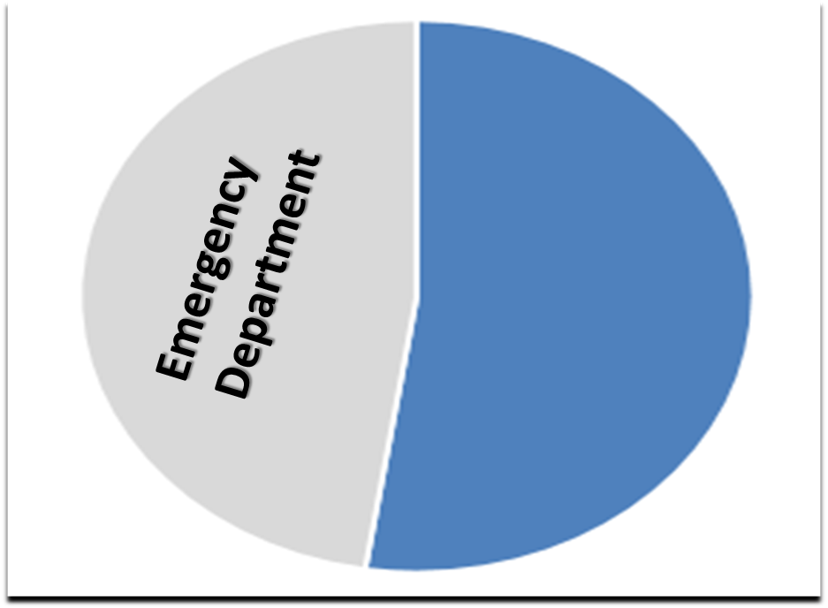

Emergency Department
Notes:
Nearly half of all US hospital associated medical care is delivered by Emergency Departments.
The impact of the emergency department (a.k.a. room) on the health system can not be overstated.
Due to limited resources, there is ongoing and continuous effort in an attempt to optimize the performance of the emergency department

Slide 3


Emergency Department
Emergency Department – Key Performance Indicators
occupancy/crowding | Mortality | Wait time | Correct diagnosis | Length-Of-Stay
Effectiveness | readmission from ED | Rate of discharge | Standard of care | ED returns
Left w/o being seen | Staff safety | Time of treatment | Patient satisfaction | Rate of complaints
……..
Notes:
There are many key performance indicators used to measure emergency departments.
This is a multi-objective optimization problem, where some of the objectives can be conflicting.
For example, reducing the wait time of patients by assigning an available physician that does not have the required specialty might cause incorrect diagnosis and reduce the standard of care
For over 70 years emergency departments have been investigated , mainly focusing on modeling patient inflow and the required staffing levels of caregivers

Slide 4



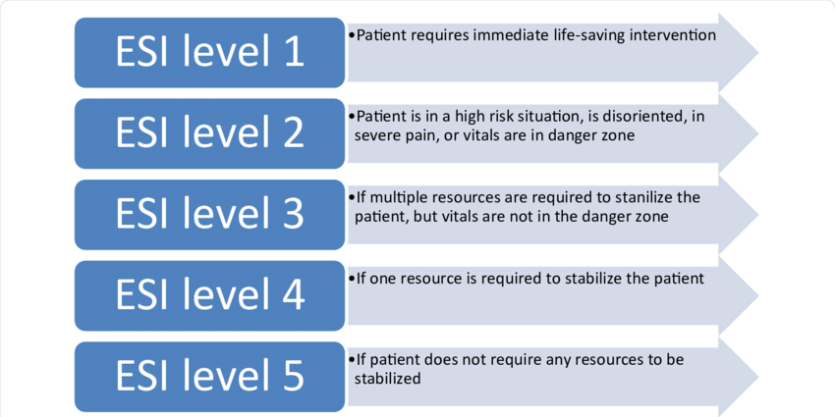




Triage
Notes:
Perhaps the central position in the ED controlling the patient flow is the Triage Nurse
When a patient arrives, the first thing to do is diagnose the severity (ESI-emergency severity index), where roughly patients of the first two levels require immediate treatment else the patient might die, patients of the next two levels require treatment but are not in a life threatening situation, and patients of the last level can wait and wait…
She decides the acuity of the patients condition , and given the injury type and the acuity decides whether to have the patient wait or be treated by one of the caregivers according to their seniority and specialty
Our focus is the process of assignment of patients to caregivers!

Slide 5
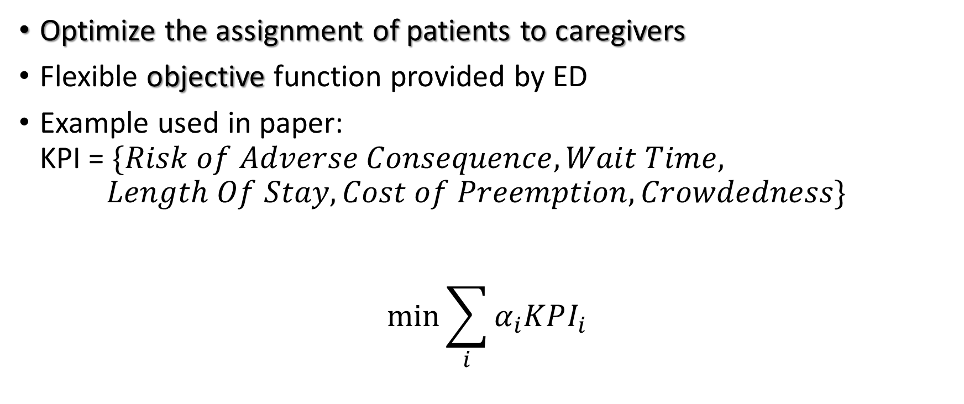
Goal
Optimize the assignment of patients to caregivers
Flexible objective function provided by ED
Example used in paper: KPI = $\{Risk of Adverse Consequence, Wait Time,$ $Length Of Stay, Cost of Preemption, Crowdedness\}$
$$\min{\sum_{i}{α_{i}KPI_{i}}}$$
Notes:
We address the optimization of the triage process, and our method provides ED management with the flexibility to select the desired KPIs and their weight in the objective function
The KPIs are mostly self-explanatory, with Risk of Adverse Consequence is an estimate proportional to the probability of something “going wrong” when a certain caregiver treats the patient.
The Cost of Preemption is a factor designed to reduce the number of times a caregiver has to leave a patient in mid-treatment when called urgently to another patient

Slide 6
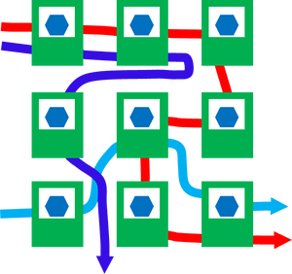


Method
Model the patient → caregiver assignment as a scheduling problem
Simply solve the scheduling problem to minimize the objective function
It is NP-Hard….
Notes:
The triage assignment of patients to caregivers is akin to the job-shop scheduling problem of unrelated machines with preemption, with the analogy of caregivers to machines and patients to incoming jobs.
This problem is known to be NP-Hard

Slide 7
Method
LBS – Learning Based Scheduling
Create a set of patient-caregiver offline optimization problems based on past patient flow data or patient flow distribution
Solve the offline optimization problem
Translate each assignment in each schedule into training instances
Train ranking model
Use the resulting scheduling policy
Notes:
Our method consists of using machine learning to train a ranking function which is used to compare the possible assignments of patients-to-caregivers and select among them.
Next, I will explain each of the steps of the method

Slide 8
Method
LBS – Learning Based Scheduling
Create a set of patient-caregiver offline optimization problems based on past patient flow data or patient flow distribution
Solve the offline optimization problem
Translate each assignment in each schedule into training instances
Train ranking model
Use the resulting scheduling policy

Slide 9

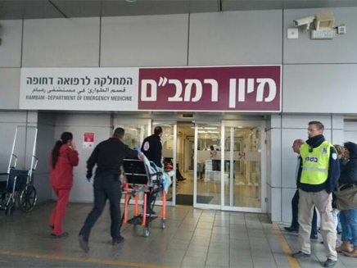

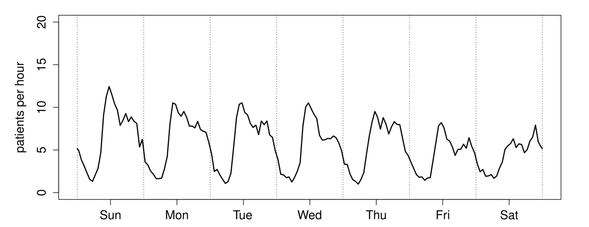
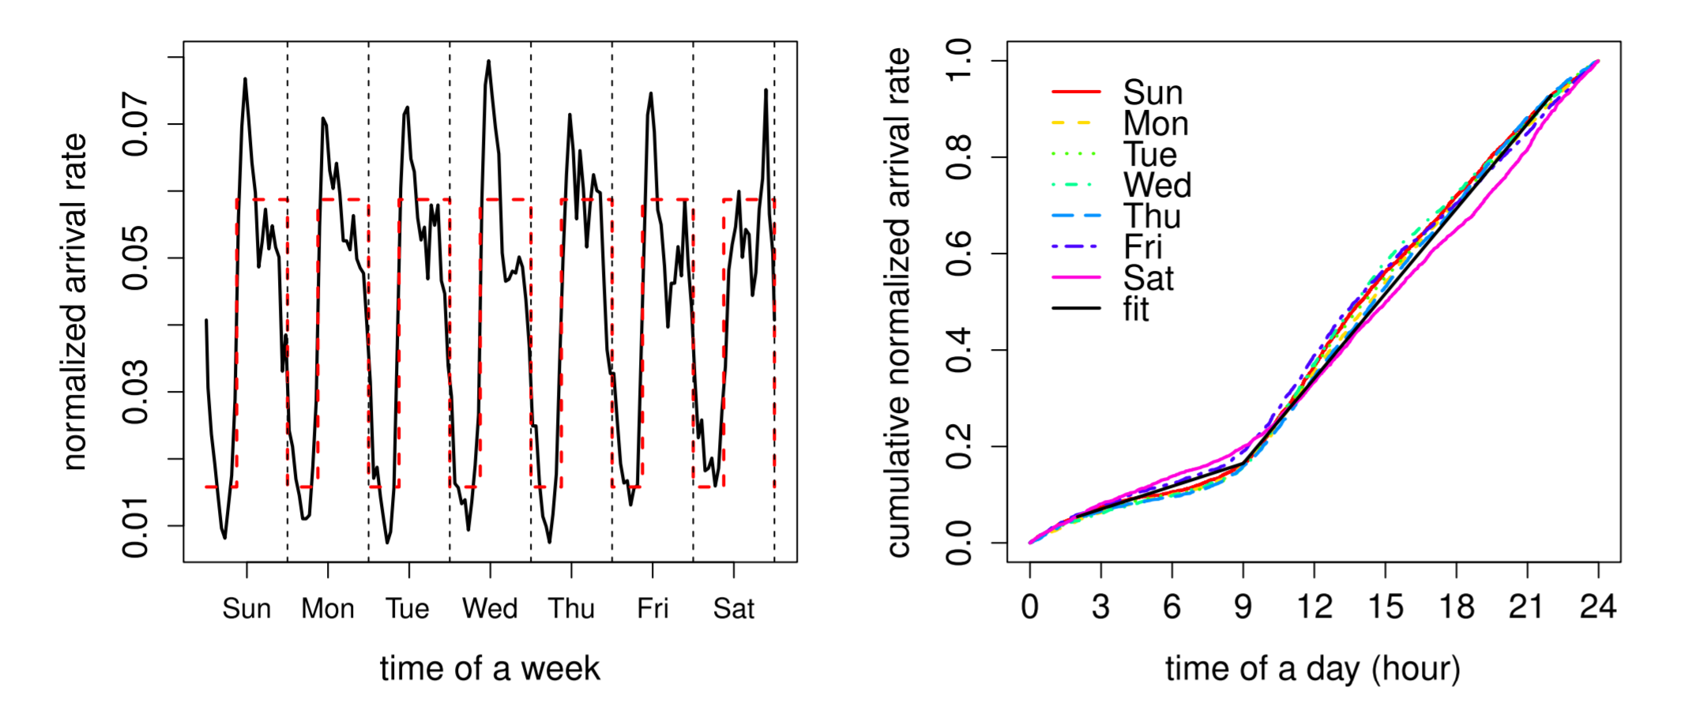
ED model
Notes:
The emergency department patient flow has been extensively studied.
Specifically, data from Rambam hospital in Haifa Israel was made publicly available and was used by many researchers.
Whitt and Zhang have demonstrated that while incoming patient flow differs on an hourly basis and on a daily basis
When normalized, the data fits a model of a conditional NHPP (non homogenous Poisson process).
Other papers provided models of the severity of patients and treatment times and lab diagnosis times.
Taken together, we had a working model from which we could sample as many scenarios as needed

Slide 10
ED patient flow
Triage
Scheduling Policy
Treatment
Discharge/ Admission
Additional Tests
<Severity, Injury type>
<Seniority, Specialty>
Notes:
Recapping, upon arrival a patient is seen by a triage nurse.
According to the patient’s injury type and severity an assignment is made to be treated by a caregiver specified by her seniority and specialty.
After a treatment, additional test may be requested, e.g. CT, bloodwork, ….
Our model assumes no more than two treatment cycles after which the patient is released from the emergency department (either goes home or admitted to an internal ward)

Slide 11
Method
LBS – Learning Based Scheduling
Create a set of patient-caregiver offline optimization problems based on past patient flow data or patient flow distribution
Solve the offline optimization problem
Translate each assignment in each schedule into training instances
Train ranking model
Use the resulting scheduling policy

Slide 12
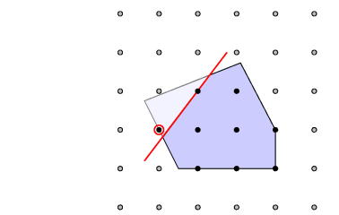
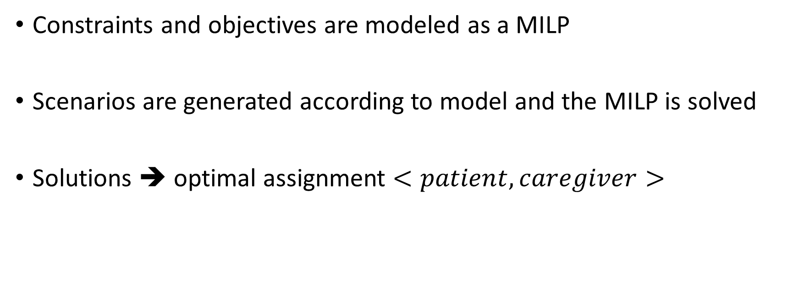
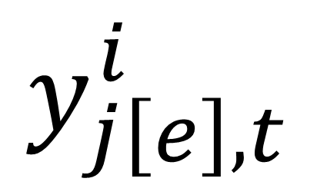
Mixed Integer Linear Program
Constraints and objectives are modeled as a MILP
Scenarios are generated according to model and the MILP is solved
Solutions ➔ optimal assignment $<patient, caregiver>$
Patient
$$y_{j\left[e\right],t}^{i}$$
Binary indicator variable:
Caregiver
Treatment-1,2
Time [min]
Notes:
A mathematical program of the problem was formulated as mixed integer linear program.
Multiple scenarios were generated and solved using Gurobi solver.
Solutions indicate the optimal assignment of patients to caregivers
The main variable in the program is a multi-dimensional binary indicator variable which is equal to one when patient_i is treated by caregiver_j in her e’th treatment at time t.

Slide 13
Method
LBS – Learning Based Scheduling
Create a set of patient-caregiver offline optimization problems based on past patient flow data or patient flow distribution
Solve the offline optimization problem
Translate each assignment in each schedule into training instances
Train ranking model
Use the resulting scheduling policy

Slide 14
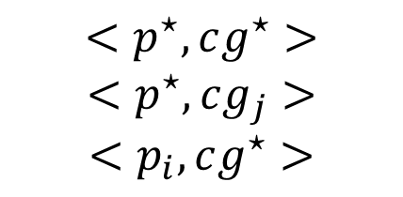
Training Dataset
Optimal Solutions
Training Dataset
Scheduling Pairs
$$<p^{⋆},cg^{⋆}>$$
$$<p^{⋆},cg_{j}>$$
$$<p_{i},cg^{⋆}>$$
Notes:
Using the set of optimized solutions generated offline, we identify the times in which a new patient arrives or when treatment of a patient is completed. For each such case, we create all scheduling pairs consisting of the selected assignments according to the optimized solution
coupled with any other assignment option which was not selected.
For simplicity, from this point onwards, we will consider the assignment to the wait-room as a dummy caregiver which can support an infinite number of patients but does not provide any treatment.
We use a combined patient-caregiver feature vector for all scheduling pairs in the training dataset.

Slide 15
Method
LBS – Learning Based Scheduling
Create a set of patient-caregiver offline optimization problems based on past patient flow data or patient flow distribution
Solve the offline optimization problem
Translate each assignment in each schedule into training instances
Train ranking model
Use the resulting scheduling policy

Slide 16
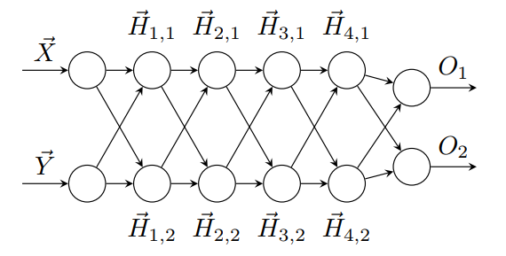

Training Ranking Function
$$O_{1}>O_{2}→\vec{X}≻\vec{Y}$$
Notes:
We use a neural network with a shared symmetrical architecture that guarantees anti-symmetry and reflexivity of its outputs. Making it well suited to act as a pairwise ranking function.
Using the previously described data set we train the network to “prefer” the optimal scheduling over the other possibilities

Slide 17
Method
LBS – Learning Based Scheduling
Create a set of patient-caregiver offline optimization problems based on past patient flow data or patient flow distribution
Solve the offline optimization problem
Translate each assignment in each schedule into training instances
Train ranking model
Use the resulting scheduling policy

Slide 18

Online Algorithm
Rank all possible scheduling pairs
Patient Arrival
Majority Rule
Caregiver EOT
Notes:
When either a new patient arrives or a caregiver is freed, all possible patient-caregiver assignments are compared using the pretrained pairwise ranking function.
The selection of the assignment is chosen according the majority rule, that is the patient-caregiver pair that “won” the most ranking comparisons.

Slide 19
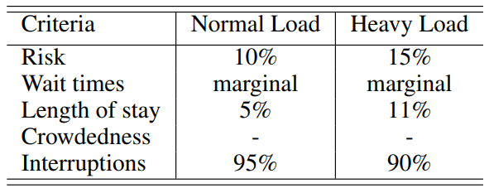
Results
Simulated data of night shift under normal and heavy (x2) load
Compared with actual ED heuristics (FCFSwU)
Notes:
We simulated many (~500) scenarios of the night shift. This shift was chosen as it has a small number of caregivers on duty.
We additionally simulated scenarios with high load, that is doubling the incoming patient flow.
The objective function was weighted by consulting a medical expert team.
We compared the resulting KPIs of our method with a heuristic used in practice in the ED: FCFSwU – First Come First Serve with Urgencies.
Out method consistently improved 4 of the 5 KPIs with no affect on the last KPI (crowdedness) under both load conditions

Slide 20
Conclusions
Our LBS method outperformed existing ED best practices
Ed have the flexibility to select patient/caregiver distribution, and objectives and retrain the ranking function
In future work we plan
Integrate our method in a hospital
Apply complex objectives
Test the applicability of scheduling scans to radiologists
Notes:
Future work

Slide 21
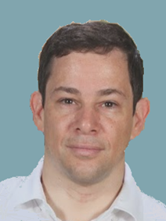
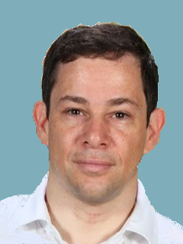
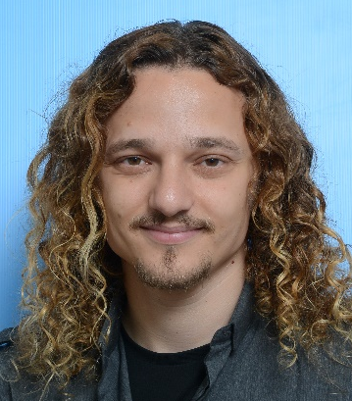

Thanks
Hanan Rosemarin Ariel Rosenfeld Sarit Kraus
h.rosemarin@gmail.com

Slide 22
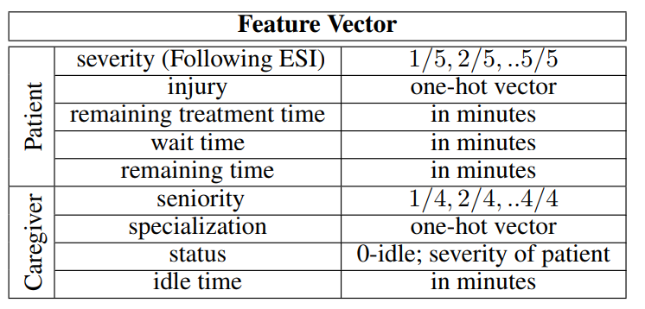
Feature Vector

Slide 23
